Slide 1
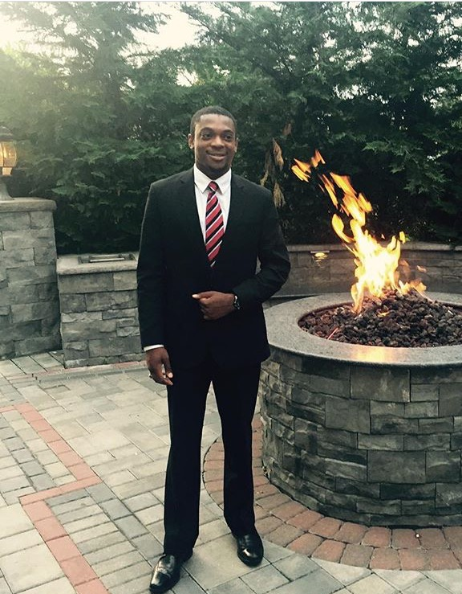
Clifton Alexander, Jr.
Clifton Alexander is a recent graduate of Kean University, with a major in Finance and a minor in Economics. He has a strong knowledge of financial markets and current economic trends. He gained Finance experience working as an intern at EverBank Commercial Finance and currently works as a Director of Client Relations and Media at Northwestern Mutual. Clifton was the winner of the 2016 Lockheed Martin Missions Systems and Training International Expansion Case Study. His personal motivations stem from wanting to expand financial literacy to minorities and lower income households. His ultimate goal is to use his passion for technology to help provide an avenue for people to gain financial knowledge and opportunities.

Slide 2

Founded by: Clifton Alexander

Slide 3
Market Opportunity
49 million Americans use personal finance management tools (PFMs)
Mint leads the pack with 15 million users
Notes:
Discuss how big the market is and how your taking a little piece of it can still be impactful and generate revenue
Time: 40 secs

Slide 4
Customer Insights
Target Demographic:
Working Class women and men
Aged 18-49
High use of computers and mobile devices
Financial reporting agencies and other businesses
Notes:
Talk about who your target customers, and the 2-3 high level points you learned about the problems they face related to your project; It would be great to mention how many folks you surveyed and interviewed; Use google forms to get exact percentages

Slide 5
Value Proposition
Users learn about finances not just track them
Fully customizable budgets
Combines many aspects of saving, investing and learning
Offers live help to users
Notes:
Discuss the main benefit(s) of your product/service for each customer segment; Mention your advantages to competitors here
Time: 40-60 sec

Slide 6
Business Model Canvas
Key Partners -Harlem business Alliance -Northwestern Mutual -Investopedia -Yodlee -Chase -Esurance | Key Activities -Provide a learning resource -account management -investment help -Reinvesting user savings | Value Propositions -Offers microfinance as an avenue for savings -provides information for investing, homebuying etc. -potential to have virtual financial advisor -Provide demographic data to Financial Reporting companies & Advertisers -Premium service – Virtual Financial Advisor | Customer Relationships -Free sign up -Premium Services | Customer Segments -Primary: Lower middle class employed individuals aged 18-35 -Segment Secondary: Middle class users ages 35-50 -Financial Reporting companies -Companies seeking demographic data to improve marketing
 | Key Resources -MicroFinance patent? -FINesse © ™ -Yodlee API -Investopedia API -Partner Relationships |  | Channels -Awareness -Evaluation -Purchase -Delivery -After sales
Cost Structure -Web and app development -Yodlee API -Investopedia API -Marketing Expense | Revenue Streams -Premium Subscription Fee -Advertising -Data(B2B) -Investing user savings into short term securities
Notes:
Present what your initial thoughts were on your business model canvas; How will you get, keep and grow customers; Who are your partners; Contrast with what you learned from class, interviews and surveys and the changes you made to the canvas (Break this into individual slides and run through quickly)

Slide 7
Revenue Model
Invest money from savings feature into short-term securities
Partner with companies to provide aggregate user data
Partner with resources to help users (i.e. Geico via snapshot)
Paid Virtual financial advisor (Future)
Notes:
Be prepared to defend your model during Q/A
Time: 60 sec

Slide 8
Go-To-Market Strategy
 | Milestone | Strategy | Cost
January 2017 | Incorporate APIs | Purchase Yodlee & Investopedia API & have developer add it to the platform | $20,000
February 2017 | Complete Platform | Developer finishes minimum viable product as per current design | $20,000
March 2017 | Focus group & Beta testing Begin Phase 1 Ad campaign | Test product and enact any revisions Begin advertising within NYC | $30,000
April 2017 | Product Launch | Launch product on | --
August 2017 | Gain 10,000 daily active users | Gain users as a result of phase 1 ad campaign | --
December 2017 | Gain 20,000 daily active users | Promote with partners to gain reach | --
Notes:
Describe how you will get your product out to the customer segments
Time: 40-60 sec

Slide 9
Founder, Clifton Alexander

